Slide 1
Investigation of Gene x Sex Interactions effects on Idiopathic Pulmonary Fibrosis
Presentation and Analysis completed by Adelle Price
Statistical Methods for Genetic Association Studies
May 14, 2022

Slide 2
Background
Idiopathic Interstitial Pneumonias (IIPs) are characterized by:
Scarring of lung tissue (pulmonary fibrosis)
Progressive lack of oxygen
Known pulmonary fibrosis associations
environmental exposures (e.g. asbestos)
drug toxicity
radiation exposure
vascular diseases

Slide 3
Background
Idiopathic Pulmonary Fibrosis (IPF)
most common and severe IIP
median survival of 2–3 years
No drug therapies for IPF approved in US as of 2013
Lung transplant was only known intervention
As of 2015, 2 drug treatments identified (modestly effective)

Slide 4
Background
Known associated variants:
Mucin 5B (Muc5B); related to properties of saliva and mucus
SNP rs35705950 (in promoter region)
associated with a 6-8x increased risk for IPF
SNP rs868903 (in promoter region)
Males account for ~70% of all IPF cases

Slide 5
Research Question
Does sex modify the effect of genotype on IPF risk?

Slide 6
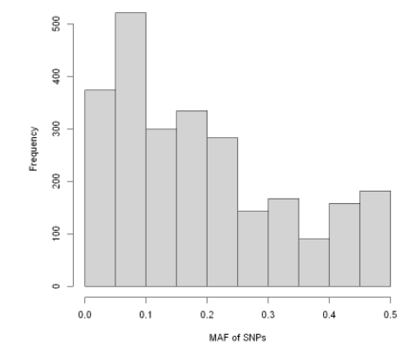
Data
Genotype data from 2555 SNPs on chromosome 11
All SNPs in HWE in controls
All SNPs have call rate >=95%
SNPs with <3% MAF removed
SNPs with differential missingness between cases and controls removed
Notes:
2204 SNPs

Slide 7
Data
8059 subjects (3617 Cases/ 4442 Controls)
European Ancestry
Subject related at 2nd degree or more removed
 | Female | Male
Control | 2610 | 1832
Case | 1033 | 2584

Slide 8
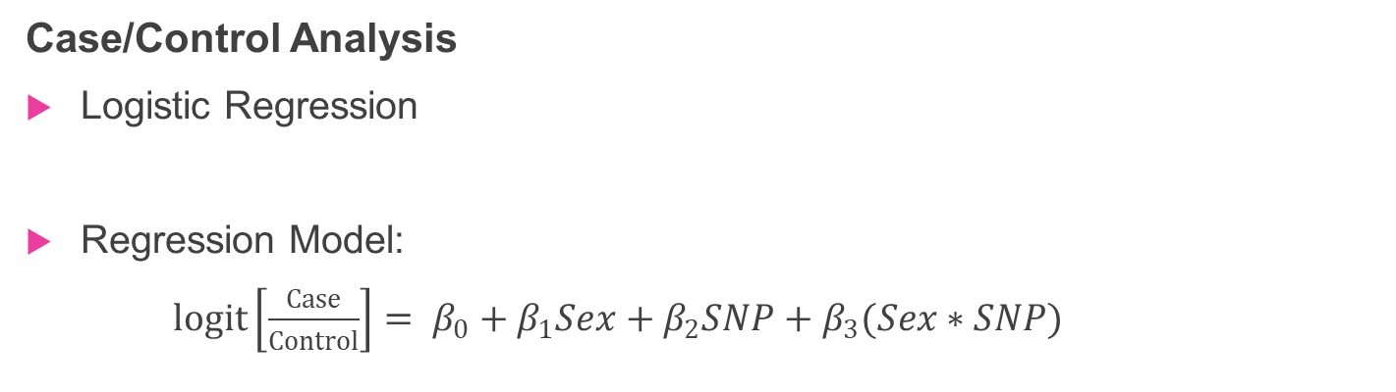
Methods
Case/Control Analysis
Logistic Regression
Regression Model:
$logit\left[\frac{Case}{Control}\right]= β_{0}+β_{1}Sex+β_{2}SNP+β_{3}(Sex∗SNP)$
Additive genetic model
1 regression model per each SNP
Significance Threshold=1.95e-05 after Bonferroni Correction
Model assumptions:
Subjects included in model are independent (unrelated)
Notes:
most common and severe IIP is IPF

Slide 9

Methods
Case Only Analysis
Logistic Regression
Regression Model:
$logit\left[Sex\right]= β_{0}+β_{1}∗SNP$
- Only cases included
Additive genetic model
1 regression model per each SNP
Significance Threshold = 1.96e-05 after Bonferroni Correction
Model assumptions:
Genotype is independent of environment
Checked with control only analysis- assumptions likely met

Slide 10
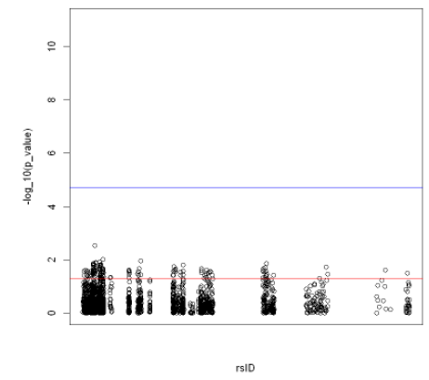
Results
Case/Control Analysis
No significant SNP x Sex Associations
Blue line on right is cutoff at 1.95e-05
131 Nominally Significant SNP x Sex interactions
.003 <= P_value <= .05
1 Notable SNP x Sex interaction:
rs7396026 x Sex (p_val: ~ .003)
Intergenic region, perhaps regulatory

Slide 11
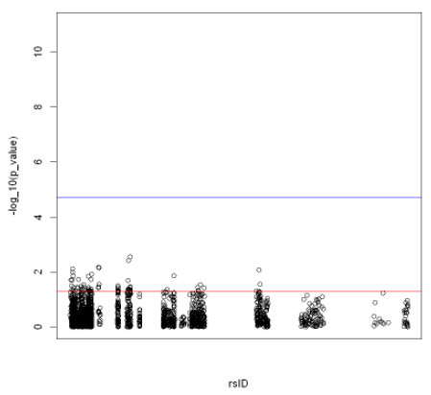
Results
Case Only Analysis
No significant SNP x Sex interaction
Blue line on right is cutoff at 1.96e-05
65 Nominally Significant SNP x Sex interactions
.003 <= P_value <= .05
2 Notable SNP x Sex interactions:
rs34830395 x Sex (p_val: ~ .003)
Intron: regulator of MOB2 gene: kinase activator
rs35678986 x Sex (p_val: ~ .004)
KRTAP5-4 gene, 3’ UTR variant: UTR is part of mRNA

Slide 12
Discussion
Case/Control Analysis Interpretations
rs7396026 x Sex
The addition of a risk allele at SNP rs7396026 in men has 2.31 times increase in the odds of IPF compared the addition of a risk allele at SNP rs7396026 in women.

Slide 13
Discussion
Case Only Analysis Interpretations
rs34830395 x Sex
The addition of a risk allele at SNP rs34830395 in men has approximately 1.38 times increase in the odds of IPF compared the addition of a risk allele at SNP rs34830395 in women.
rs35678986 x Sex
The addition of a risk allele at SNP rs35678986 in men has approximately 1.40 times increase in the odds of IPF compared the addition of a risk allele at SNP rs35678986 in women.

Slide 14
Conclusion
No strong evidence for gene x sex interaction affects on IPF risk
No evidence for gene x sex interaction for SNP rs7942850 (in promoter region of Muc5B):
interaction term p-value ~ 0.83
No evidence for gene x sex interaction for SNP rs868903 (in promoter region of Muc5B):
interaction term p-value ~ 0.53
No nominally significant SNP x Sex interactions contain known IPF SNP associations
Consistent with analysis results in Fingerlin et al.

Slide 15
References
Fingerlin, T., Murphy, E., Zhang, W. et al. Genome-wide association study identifies multiple susceptibility loci for pulmonary fibrosis. Nat Genet 45, 613–620 (2013). https://doi.org/10.1038/ng.2609
Kropski JA, Blackwell TS, Loyd JE. The genetic basis of idiopathic pulmonary fibrosis. Eur Respir J. 2015 Jun;45(6):1717-27. doi: 10.1183/09031936.00163814. Epub 2015 Apr 2. PMID: 25837031; PMCID: PMC4849867.
Liu, Chen-yu et al. “Design and analysis issues in gene and environment studies.” Environmental health : a global access science source vol. 11 93. 19 Dec. 2012, doi:10.1186/1476-069X-11-93
uswest.ensembl.org

